Slide 1
Digital Transformation & Industry 4.0/5.0

Slide 2
Digital
Digital refers to electronic technology that represents:
processes, and stores data using discrete values, typically expressed in binary form as 0s and 1s.
This contrasts with analog technology, which conveys data in continuous signals.
Digital devices use this binary system to transmit and manipulate information efficiently and reliably.

Slide 3
Digital Transformation
Digital transformation is the method of integrating digital technology into all parts of a business, which changes how you run your business and give customers value.
The main advantages of digital transformation are:
increased efficiency
greater business quickness,
and, in the end, the release of new value for employees, customers, and shareholders.

Slide 4
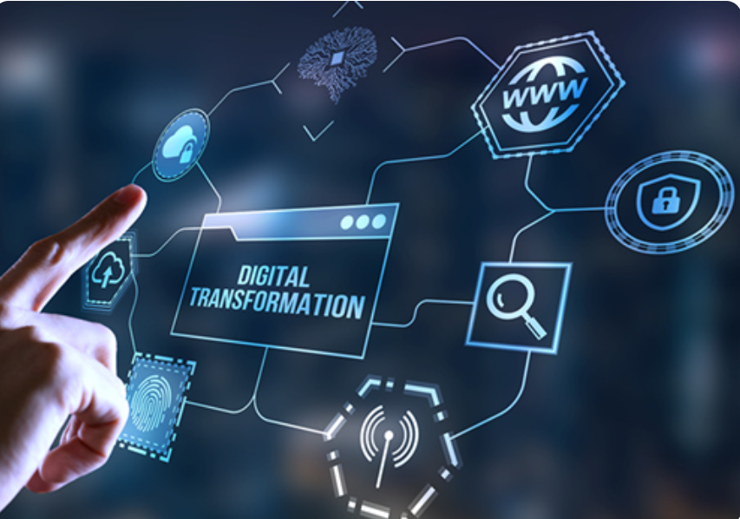
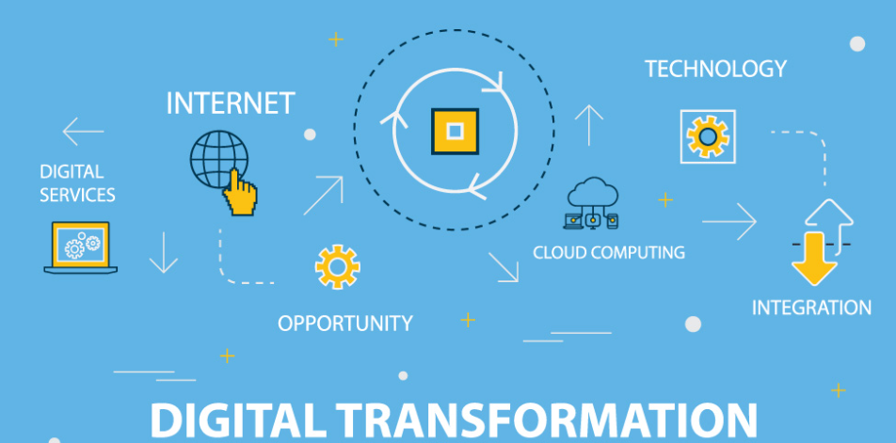
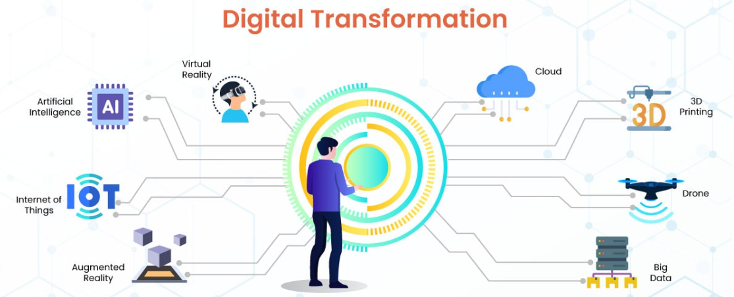
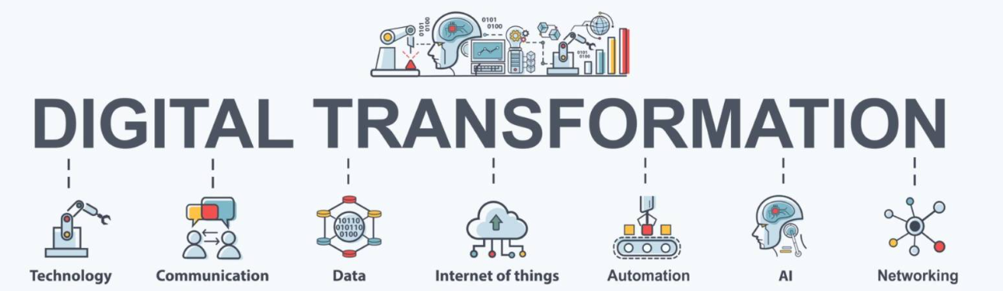
Digital Transformation

Slide 5
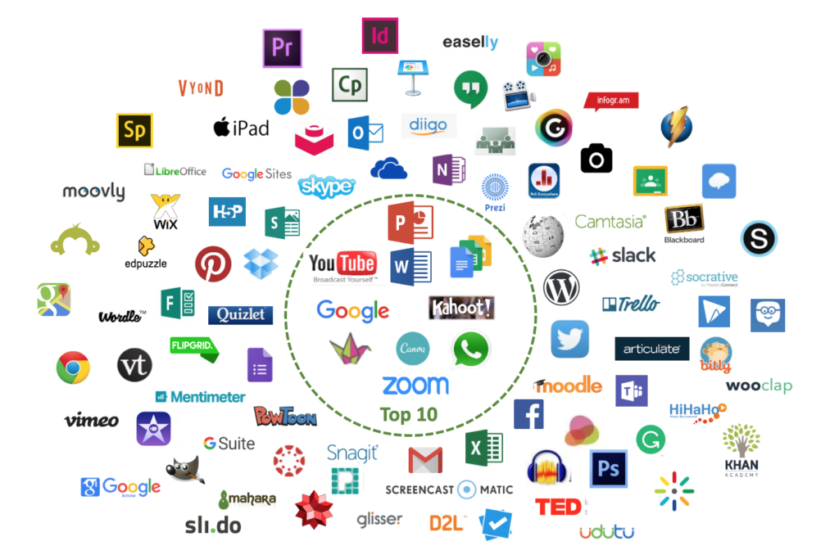
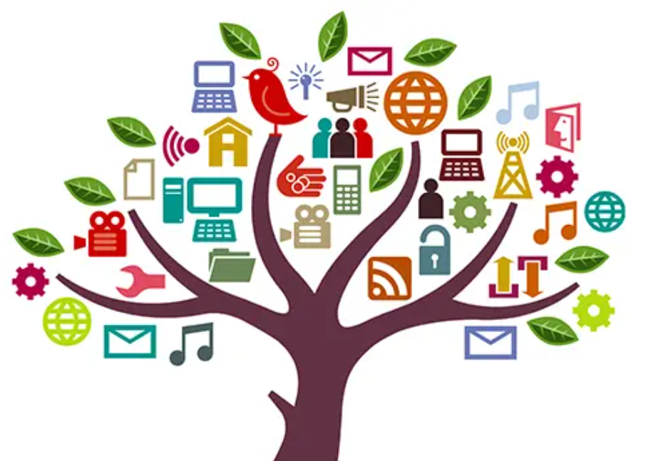
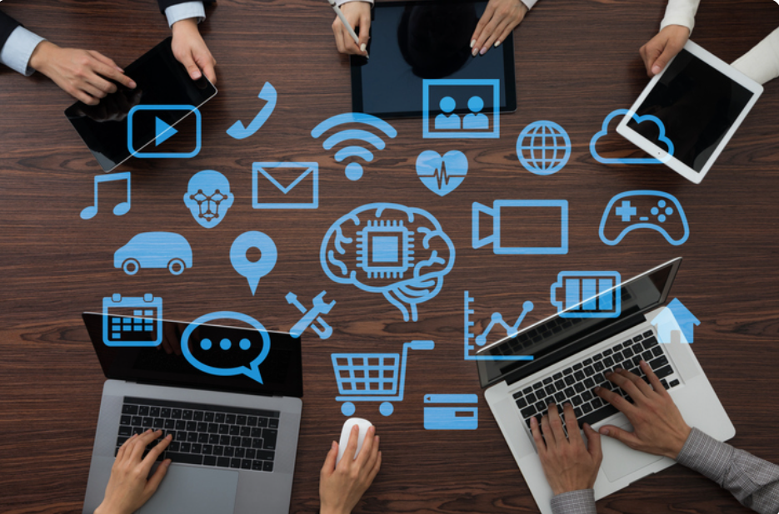
Digital Tools
Digital tools are software applications or platforms that help perform tasks, improve efficiency, and support communication and collaboration using digital technology.

Slide 6
Digital Tools for Healthcare
Digital tools for healthcare are electronic devices, software applications, platforms, and technologies used to enhance the delivery, management, and accessibility of healthcare services.
Digital tools are updating the healthcare by improving access, efficiency, and patient outcomes.

Slide 7
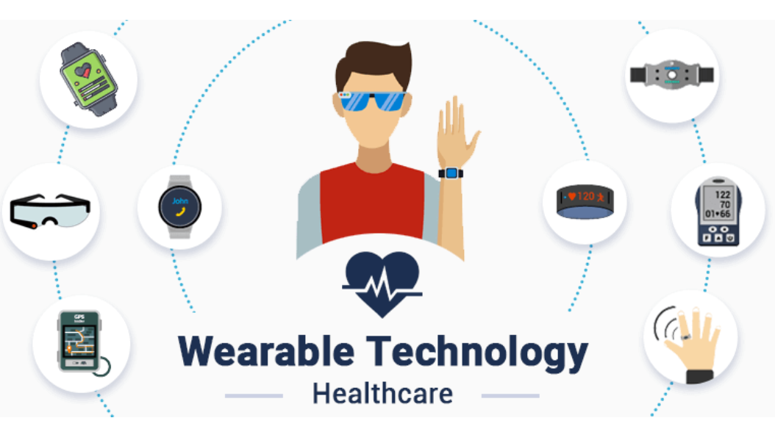
Wearable Technology / Wearable Devices
Wearable technology or wearables devices are the electronic devices that are worn on a person’s body (typically close to the skin) to send vital medical, biochemical correctly, and exercise data to a database.

Slide 8
How Do Wearable Devices Work in Healthcare
Wearable devices use sensors to gather physiological data directly from the body, which is wirelessly transmitted to smartphones or cloud platforms.
AI and machine learning analyze this data to provide real-time health insights and alerts for potential issues, enabling proactive healthcare management.

Slide 9
Main Benefits of Wearable Devices for Patients and Healthcare Providers
Benefits include continuous real-time health monitoring.
Early detection of potential health problems.
Improved chronic disease management.
Greater patient engagement with their health.
Reduced healthcare costs.
Decreased workload for medical staff through remote monitoring.

Slide 10
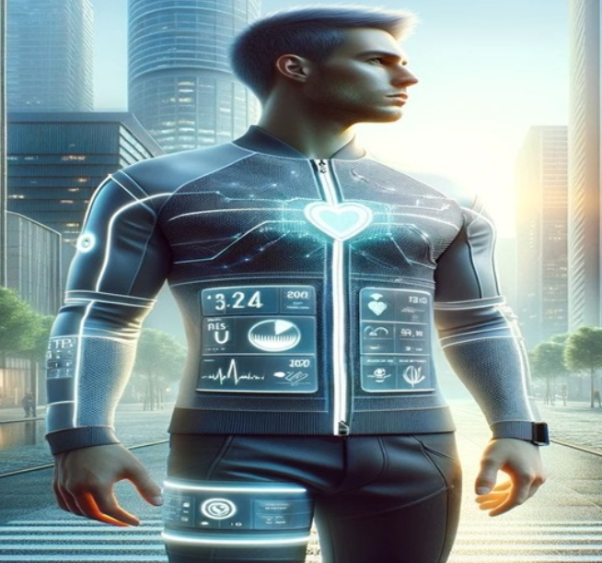
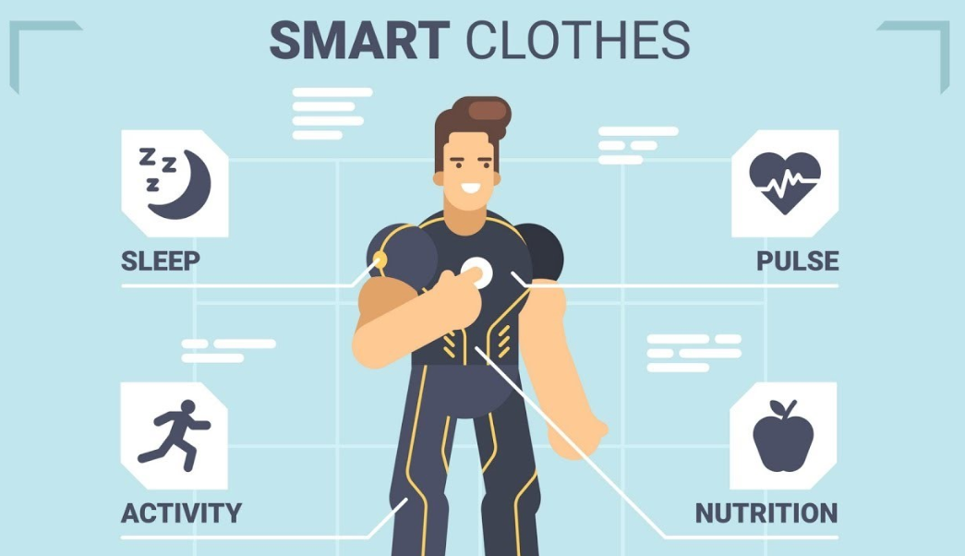
Types of Wearable Devices
Smart clothing, also known as e-textiles or intelligent clothing, refers to garments embedded with electronic components such as sensors, actuators, and conductive threads that monitor and collect data related to physical movements, environmental factors, and biological signals like heart rate, body temperature, muscle activity, or posture.

Slide 11
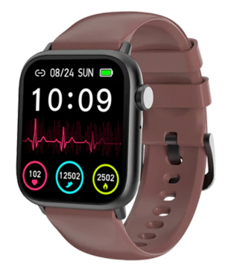
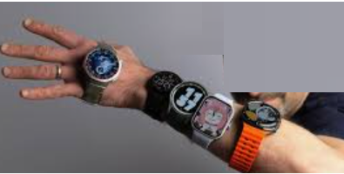
Types of Wearable Devices
Smartwatch is a wearable computing device worn on the wrist that resembles a traditional wristwatch but offers many smartphone-like features. It typically has a touchscreen and connects to a smartphone via Bluetooth or cellular network to extend the phone's capabilities. Smartwatches can display notifications such as calls, texts, and social media alerts, and allow users to make and answer calls, send messages, and interact with digital assistants.

Slide 12
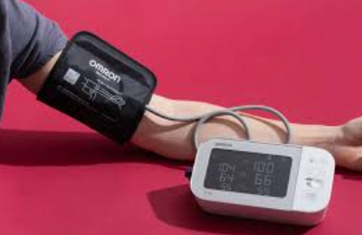
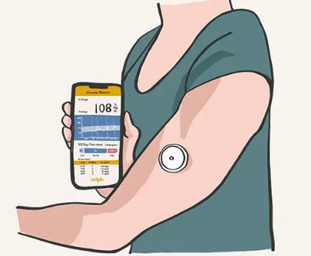
Types of Wearable
Fitness trackers.
Smartwatches.
Blood pressure monitors.
Wearable ECG monitors.
Continuous glucose monitors (CGMs).
Blood Pressure Monitor
CGMS

Slide 13
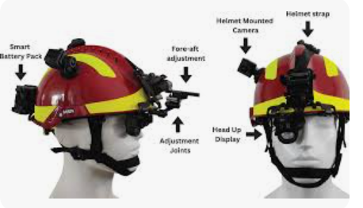
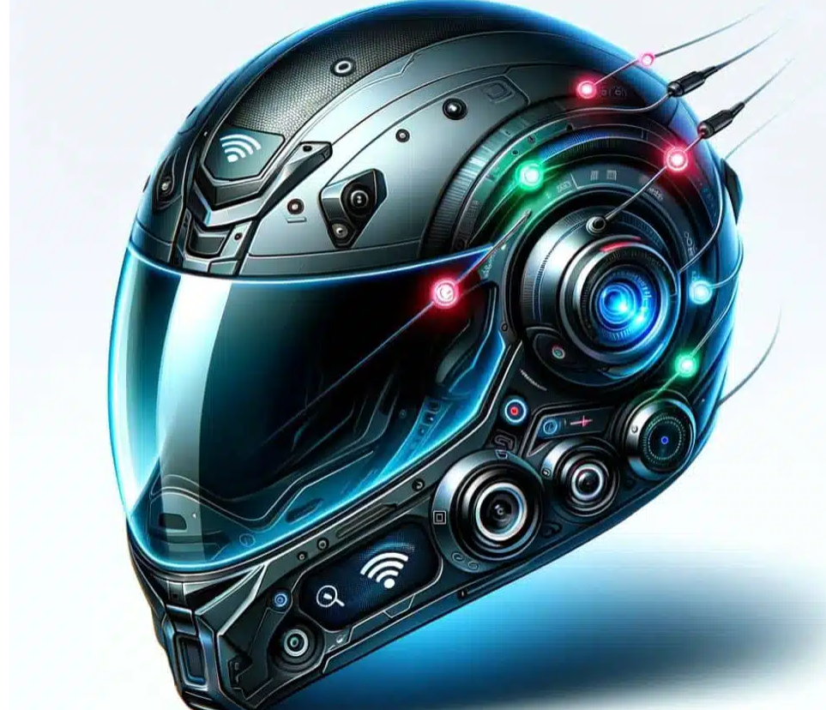
Types of Wearable Devices
A smart helmet is an advanced wearable device that integrates digital technology into a traditional helmet to enhance safety, communication, and user experience across various fields such as construction, cycling, motorcycling, and industrial work.
These helmets are equipped with features like:
Augmented Reality (AR): Displays navigation, speed, blueprints, or other real-time data on the visor.
Health Monitoring: Tracks vital signs including heart rate, body temperature, and fatigue levels.

Slide 14
Types of Wearable Devices
Safety Sensors: Includes impact detection, fall detection, and emergency alert systems (SOS) that notify contacts in case of an accident.
Communication Systems: Hands-free calls, intercoms, voice commands, and app-based walkie-talkie functions facilitate seamless communication.
Environmental Monitoring: Detects hazardous conditions like heat, air quality, or harmful gases.
Entertainment: Music streaming and video playback capabilities.
Connectivity: Uses Bluetooth, Wi-Fi, or IoT to connect with other devices and systems for real-time data sharing and control.

Slide 15
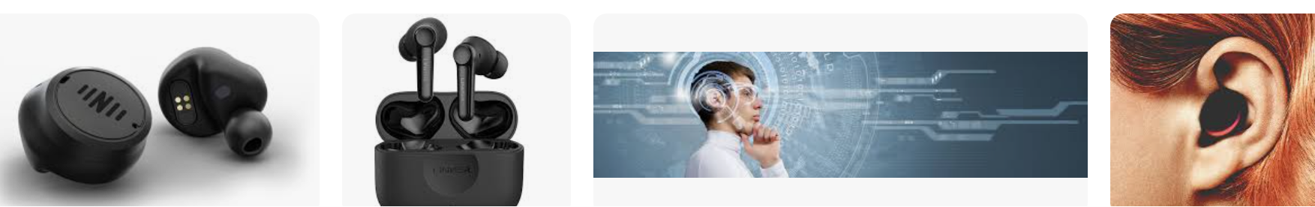
Types of Wearable Devices
A smart hearable is a wearable electronic device designed to be worn in or on the ear that combines traditional headphone or earbud functionality with advanced digital features such as health monitoring, voice assistance, communication, and connectivity capabilities.
Smart hearables typically include sensors that can track health metrics like heart rate, body temperature, and oxygen levels while providing wireless audio playback, noise cancellation, hands-free calling, and integration with virtual assistants.
They are part of the broader wearable technology ecosystem, enhancing personal health, communication, and convenience through intelligent, ear-centered devices.

Slide 16
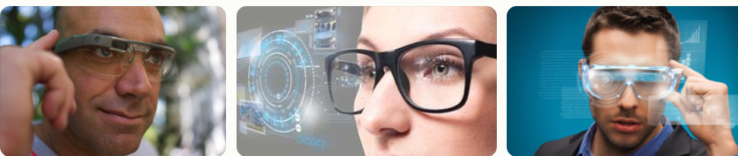
Types of Wearable Devices
Smart glasses are wearable electronic devices that look like regular eyeglasses but include built-in computer technology such as miniature displays, cameras, sensors, processors, and wireless connectivity.
They project digital information—like notifications, navigation prompts, or augmented reality (AR) content—directly onto the lenses within the user’s field of vision, enabling hands-free access to data and interactive digital experiences while still being able to see the real world.

Slide 17
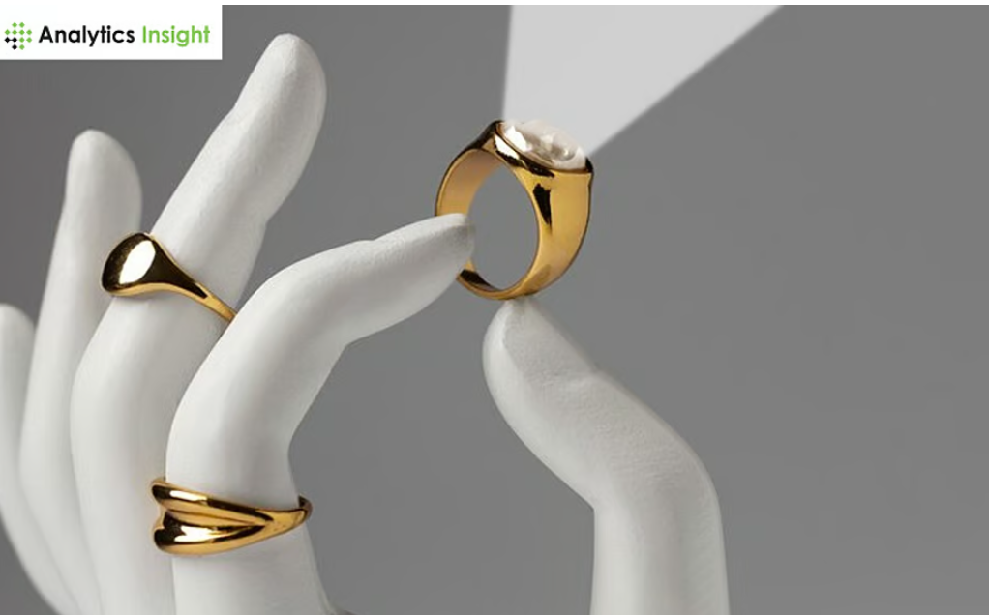
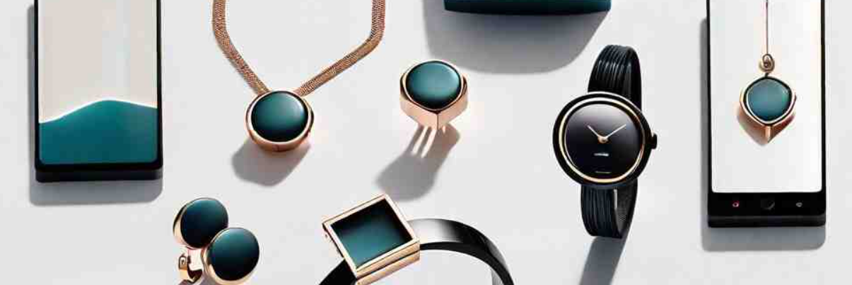
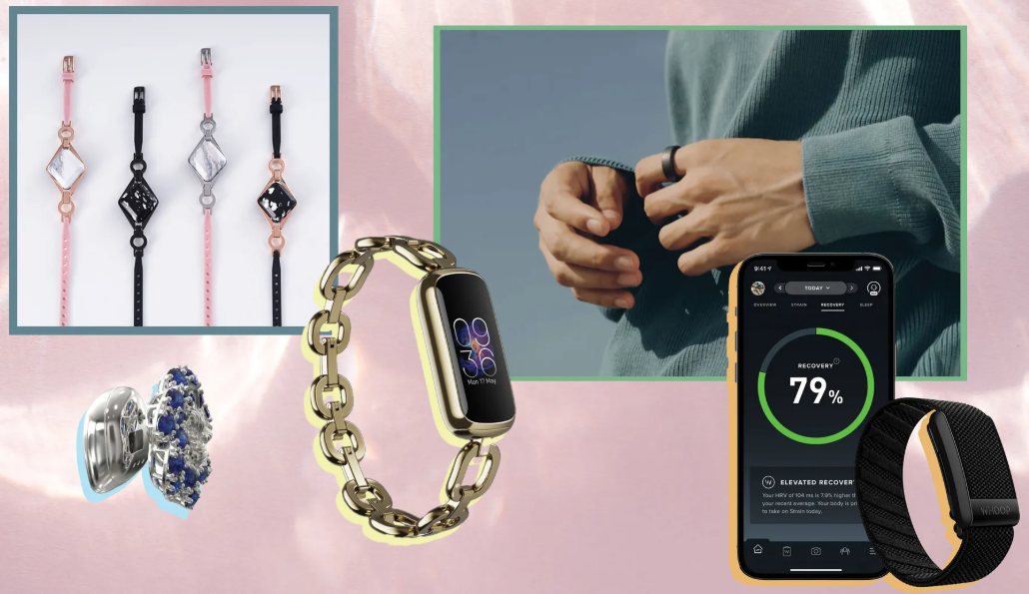
Types of Wearable Devices
Smart jewelry refers to wearable accessories like rings, bracelets, necklaces, or pendants that integrate electronic components such as sensors, microprocessors, and wireless connectivity.
These devices combine the beautiful appeal of traditional jewelry with functionalities typically found in wearable technology.
Smart jewelry can monitor health metrics (e.g., heart rate, sleep patterns, activity levels), provide notifications (calls, texts, alerts), enable contactless payments, or support safety features like emergency SOS signals—all while maintaining a stylish, discreet appearance.

Slide 18
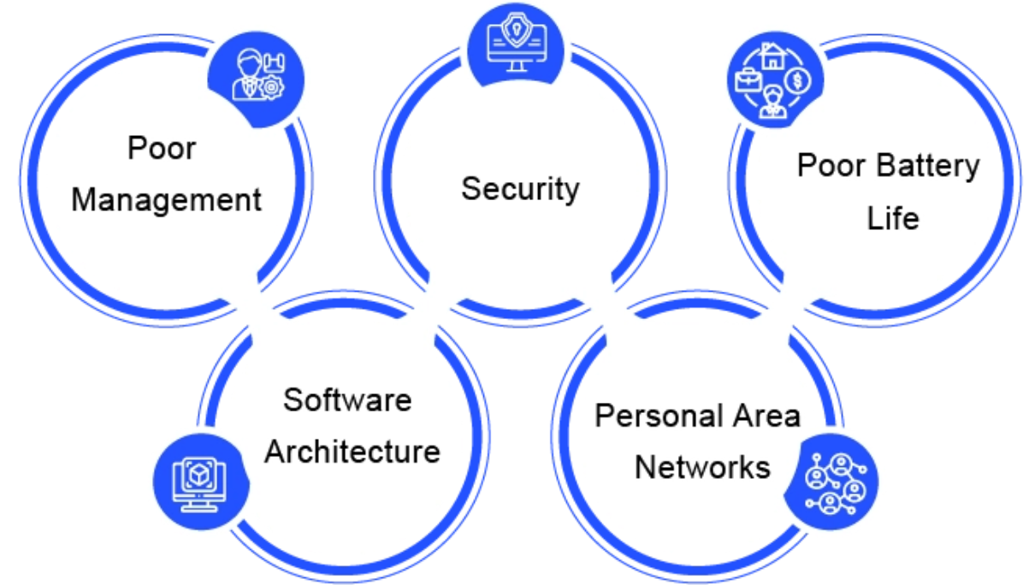
Key Challenges in Wearable Technology

Slide 19
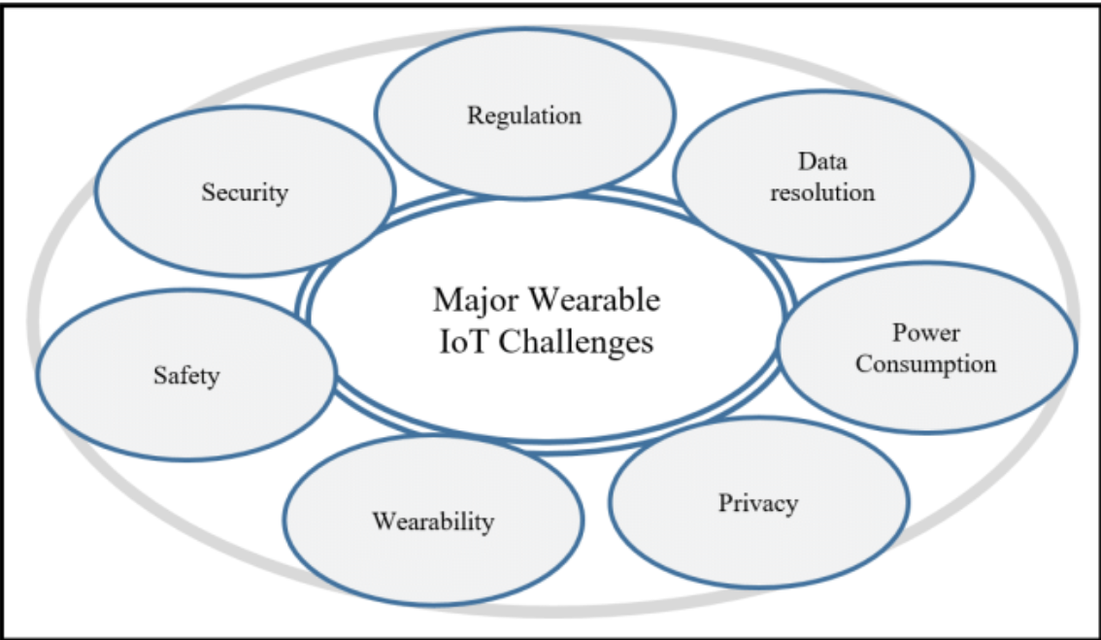
Key Challenges in Wearable Technology

Slide 20
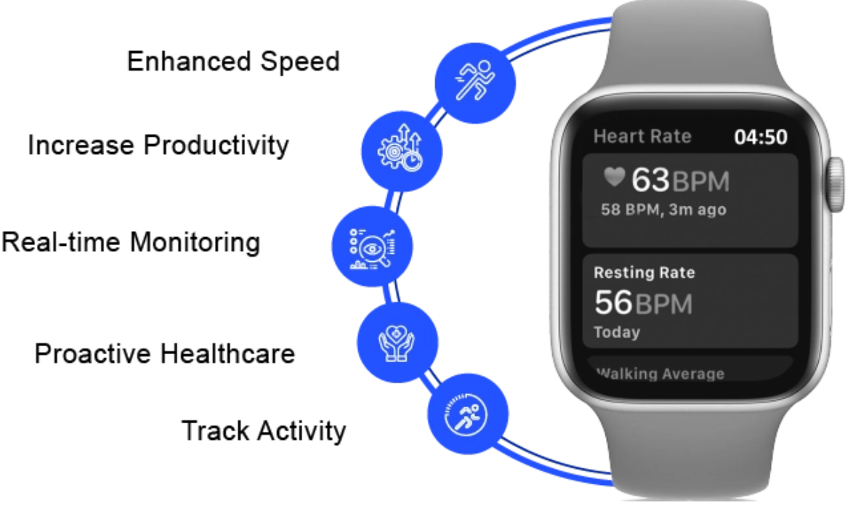
Benefits of Wearable Technology

Slide 21
Telemedicine and Remote Consultations

Slide 22
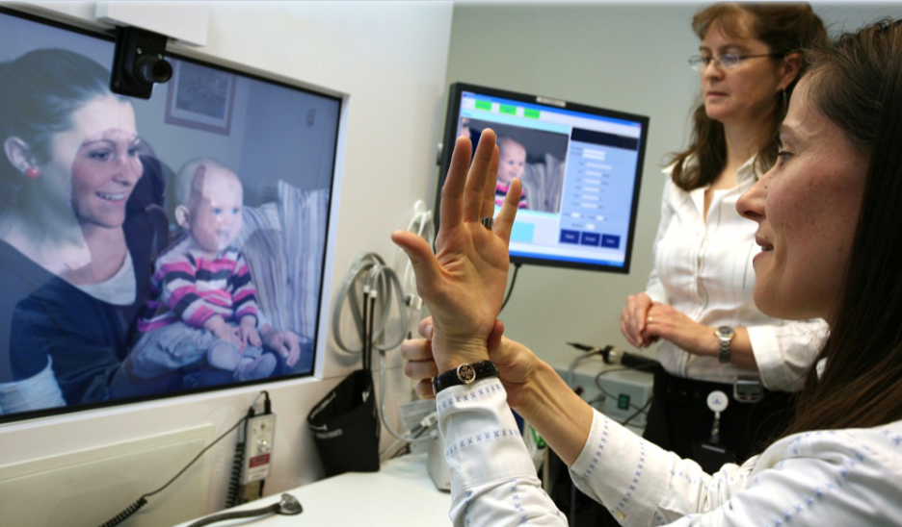
Telemedicine and Remote Consultations
Telemedicine platforms enable virtual consultations via video conferencing, expanding access to care, especially for those in remote areas.

Slide 23
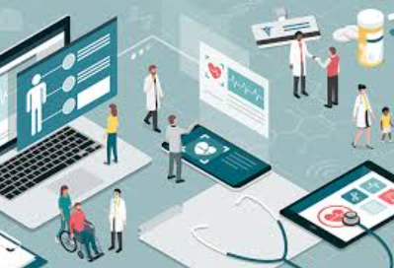
Electronic Health Records (EHRs)
An electronic health record (EHR) is the systematized collection of electronically stored patient and population health information in a digital format.
Electronic Health Records (EHRs) are digital versions of patients' health information, providing a comprehensive and easily accessible record of a patient's medical history.
They include details like diagnoses, treatment plans, prescriptions, allergies, and lab results, facilitating efficient and coordinated care across different healthcare settings.
EHRs streamline the management and sharing of patient information, improving communication between healthcare providers and enhancing care coordination.

